Slide 1
Packages

Slide 2
Agenda
Packages
Creating packages
Class member access
Working with Classpath

Slide 3
Introduction to Packages
Why Packages
To avoid naming conflicts
To control access
To achieve Reusability
What is Package
A package is a group of related types (classes, interfaces etc.) providing access and namespace management

Slide 4
Predefined Packages
Already defined in the Java API library & can be imported into user programs
Examples of predefined packages:
Core packages
java.lang.*; Frequently required Operations (By default, it is imported)
java.util.*; Utility Operations
java.sql.*; Database operations
java.net.*; Networking operations
java.io.*; File related operations
java.awt.*; GUI operations
Extended Packages
javax.sql.*; Database
javax.servlets.*; Servlets

Slide 5
Creating Packages
A package allows logical grouping of classes
Strict file & directory naming conventions and organization
All classes put into a package must reside in a directory with that package name
Package name is strictly specified at the beginning of the java code
The package statement defines a name space in which classes are stored.
If we omit the package statement, the class names are put into the default package, which has no name
package myPackage;
public class MyClass {
MyClass()
{
}
}

Slide 6
Class Member Access
Access Rights for different Elements
Class \ Has access to | Private Elements | Default Elements (no modifier) | Protected Elements | Public Elements
own class (Base) | yes | yes | yes | yes
subclass - same package (SubA) | no | yes | yes | yes
class - same package (AnotherA) | no | yes | no | yes
subclass - another package (SubB) | no | no | yes | yes
class - another package (AnotherB) | no | no | no | yes

Slide 7
Working with Classpath
How does the Java run-time system know where to look for packages that you create?
First, by default, the Java run-time system uses the current working directory as its starting point. Thus, if your package is in a subdirectory of the current directory, it will be found.
Second, you can specify a directory path or paths by setting the CLASSPATH environmental variable.
Third, you can use the –classpath option with java and javac to specify the path to your classes
For example, consider package MyPackage
In order for a program to find MyPackage, one of three things must be true.
Either the program can be executed from a directory immediately above MyPackage,
or the CLASSPATH must be set to include the path to MyPackage,
or the –classpath option must specify the path to MyPackage when the program is run via java.

Slide 8
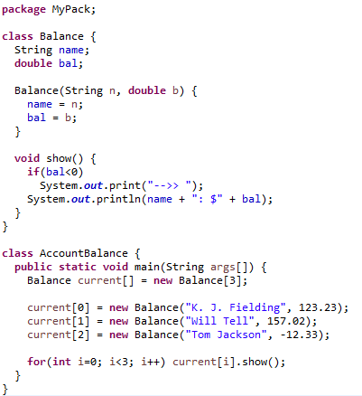
Package Example

Slide 9
Working with Classpath
Java uses file system directories to store packages.
The .classfiles for any classes you declare to be part of MyPack must be stored in a directory called MyPack/ is significant, and the directory name must match the package name exactly.
More than one file can include the same package statement.
The package statement simply specifies to which package the classes defined in a file belong. It does not exclude other classes in other files from being part of that same package.

Slide 10
Importing Packages
In java all of the standard classes are stored in some named package.
If we need use some classes from different package we should import that package using import statement
Once imported, a class can be referred to directly, using only its name.
To specify either an explicit class name or a star (*), which indicates that the Java compiler should import the entire package.
import pkg1[.pkg2].(classname|*);
import java.util.Date;
import java.io.*;

Slide 11
THANK YOU!!
ANY QUESTIONS??

